Slide 1

Sales Analytics& Inventory Optimization System
Name: Prince Yadav
Roll No : 202410101150212
Group : 47,48
Subject Name: Computer Organization and Architecture
Summited To: Dr. Akhilesh Kumar Gupta
Sales analytics & inventory optimization using Scilab

Slide 2

Introduction
01
In modern business, companies generate large amounts of sales data every day. This data can be used to improve business decisions, increase profit, and maintain proper inventory levels.
This project uses Scilab to analyze the given sales CSV file and optimize inventory management using mathematical calculations and graphs.

Slide 3
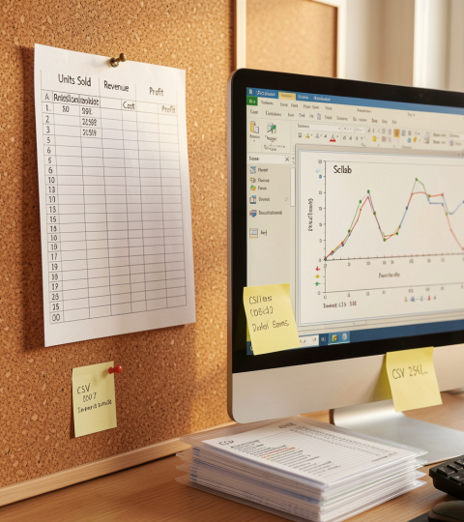
Dataset Overview
02
Dataset Information
The dataset used in this project is Sales.csv.
Dataset Details
Total Records: 100 Orders
Total Columns: 14
Major Fields Used
Units Sold
Unit Price
Unit Cost
Total Revenue
Total Cost
Total Profit
Additional Fields
Region
Country
Sales Channel
Order Priority

Slide 4
03
Existing Business Problems
Many companies face operational challenges such as:
Overstocking products
Stock shortages
Manual sales reporting
Poor forecasting methods
Slow decision-making
Difficulty analyzing profit trends
This project solves these problems using automated analytics.

Slide 5
Project Objectives
04
The main objectives of this project are:
Analyze total sales performance Compare revenue, cost, and profit Visualize data using graphs Identify business trends Calculate reorder level Improve inventory efficiency

Slide 6
05
Tools & Technologies
Software:
Scilab
Input:
CSV Dataset
Techniques:
Data Processing
Statistical Analysis
Graphical Dashboard
Inventory Optimization Formula
Outputs:
9 Graphs
Summary Report
Reorder Recommendation

Slide 7
Working Process
06
Sales.csv File ↓ Import in Scilab ↓ Read Required Columns ↓ Perform Calculations ↓ Generate Dashboard Graphs ↓ Compute Reorder Level ↓ Display Results

Slide 8
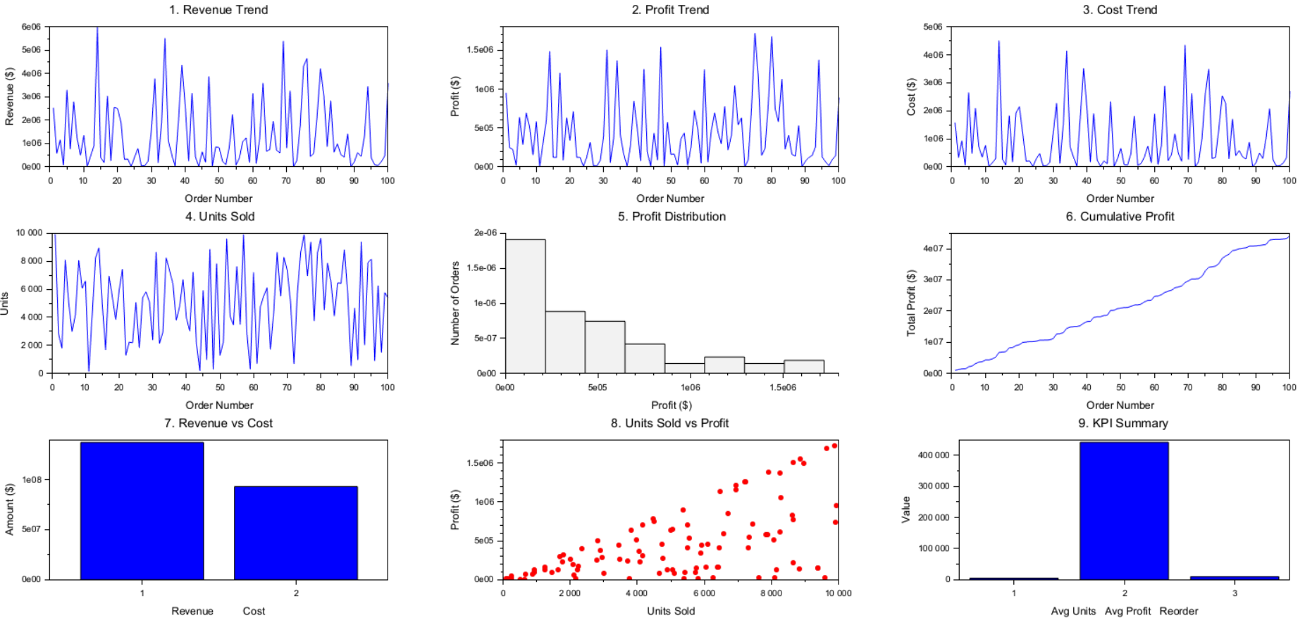
07
Visual Reports Generated
Revenue Trend
Profit Trend
Cost Trend
Units Sold Analysis
Profit Distribution
Cumulative Profit
Revenue vs Cost
Units Sold vs Profit
KPI Summary
.

Slide 9
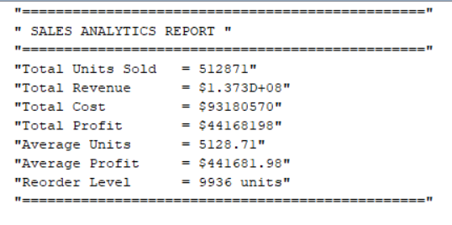
08
Output Generated by Scilab
Records Processed: 100 Orders Successfully Analyzed
Key Results:

Slide 10
Reorder Level Calculation
09
Formula Used:
Reorder Level = Daily Demand × Lead Time + Safety Stock
Project Result:
Lead Time: 7 Days
Safety Stock: 100 Units
Recommended Reorder Level: 450 Units
Benefits:
Prevent stockouts
Reduce overstocking
Better warehouse planning

Slide 11
08
Conclusion
The Sales Analytics & Inventory Optimization System successfully analyzed the sales dataset using Scilab.
Final Outcomes:
Sales performance evaluated
Revenue, cost, and profit compared
Graph dashboard generated
Inventory reorder level calculated
Better business decisions supported
Future Scope:
AI-based demand forecasting
Real-time dashboard
Automated alertsCloud integration

